Slide 1
Pulse oximeter

Slide 2
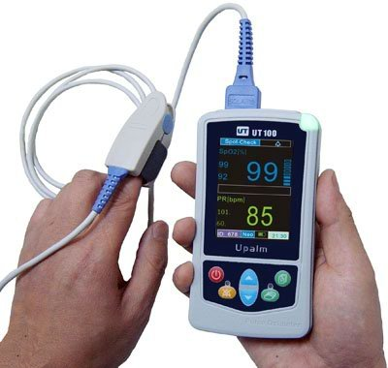
Pulse oximeter

Slide 3
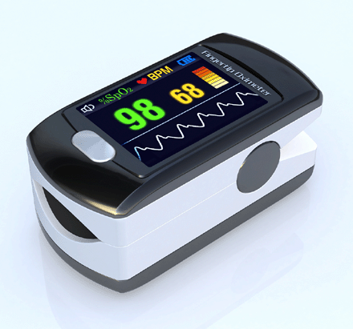
Pulse oximeter
Original patent

Slide 4
Your data
Big deep breaths
and then hold
Damn, I want some air
Gave up

Slide 5
Photodiode detection
Photodiode: Current is proportional to amount of light hitting the detector

Slide 6
Detection demo

Slide 7
We will do something else…

Slide 8
Hysteretic oscillator

Slide 9
Hysteretic oscillator

Slide 10
LED Driver
2.5 V

Slide 11
Background

Slide 12
Background + red
Detector sees the sum of the two curves

Slide 13
Background + red + ir
Detector sees the sum of the three curves

Slide 14
Convert driving signal to +/- 1

Slide 15
Multiply +/- 1 and detector
Driving * Detector
Blue – bg only
Red – bg + red LED
Black - bg +red + ir

Slide 16
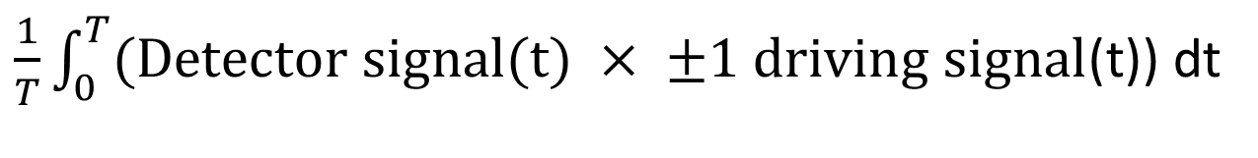
Integrate w.r.t time - background
$\frac{1}{T}\int_{0}^{T}{(\text{Detector} \text{signal}\text{(}\text{t}\text{) }× ±1 \text{driving} \text{signal}}$(t)) dt

Slide 17
Integrate w.r.t time - bg +red

Slide 18
Integrate w.r.t time - bg +red+ir

Slide 19
Converges to average difference between red and ir
We will keep the running integral by using a low-pass filter

Slide 20
Low-passed result

Slide 21
How do we implement a low pass filter in software?

